Slide 1
Filipino Culture: the Negative and the Positive
By Carmela de Leon

Slide 2
Emotional Neglect/Abuse
Making family feel guilty for:
Not having certain items, brands, experiences (cars, house, vacation etc.)
Not having achieved certain hallmarks of success
Not meeting all the expectations set forth by parents
Emotional Negligence
Denying, changing, or ignoring emotions their child feels (ex: “stop being so dramatic”)
Emotions include: being sad, upset, & more complex emotions like embarrassment, shame regret, jealousy, worry etc.
Focusing only on positive emotions
Not allowing child to express all of their emotions (ex: “just be strong, you have to move on”)
Toxic culture tends to happen in the family dynamic
Toxic behaviors
comparisons (sibling to sibling or other family members)
Comments on:
Physical appearance
Career choices
Marital choices (Baylosis, 2018)

Slide 3
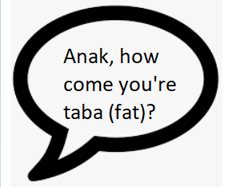
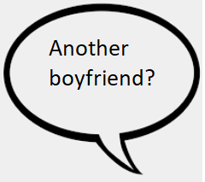
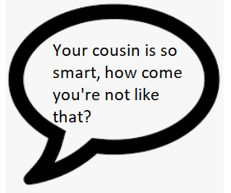
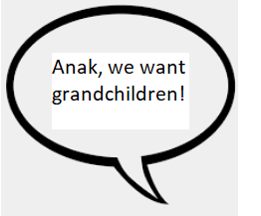
The Conditional Love
Children are taught to achieve success as interpreted by their parents
Children are taught that love is conditional - they will be accepted once they achieve high levels of success (most never achieve desired level of success)
Children are taught to accept maltreatment out of respect for the elderly
Children feel constantly judged and under scrutiny
They also become ostracized or asked to leave the home if they speak up about maltreatment

Slide 4
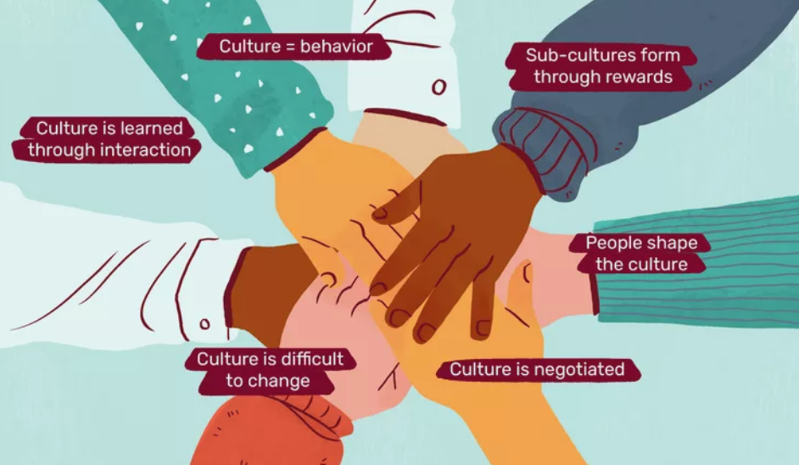
These behaviors persist due to strong cultural ties
Children are not encouraged to have conversations regarding how they are treated
The elderly are considered to be right, even if they are toxic (lack of self awareness)
These behaviors are not deemed toxic by those who participate in these behaviors

Slide 5
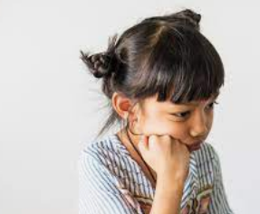
The Conditional Love: Results
Many children come from parents who exercised the authoritarian style of parenting
Authoritarian parenting style produces children with low self esteem
Children stray from their culture and family because they associate it with hurt, guilt, fear, anger, sadness
Children have poor decision making skills, fear of failure, emotional suppression, difficulty handling negative emotions (Bahrami et al., 2018)
They have poor social skills and academic competence
They develop mental health problems such as depression

Slide 6

Filipino culture is very family oriented
If someone struggles, family comes together to help
Lots of delicious food, karaoke, and parties
Children are taught responsibility
Everyone is treated like family
The Positives

Slide 7
Solutions
It is time to start having conversations with loved ones
Family members can learn new ways of thinking & speaking:
daughter/son can admit that these statements hurt. Ex: “it hurts when you call me fat. I feel as if you don’t love me and accept me for who I am. I am happy with my weight and I would prefer it if you no longer make comments about my weight.”
Other statements can help bring awareness to the perpetrator: “if someone were to call you fat, how do you think that make you feel? If you would feel sad or upset, you would be right to feel that way. That is how I feel when I am called fat.”
Parents can affirm that these statements and expectations do hurt
Family members can start to work on changing their speech “Anak, I only mention weight bc I want you to be healthy and live a long life. If you are doing your best to eat generally well and exercise when you can, I am satisfied with that. I also understand that it is your body and I trust that I instilled values in you that help you make the best decisions for yourself. I love you regardless of your weight.”
If someone is not open or willing to change, it is okay for an individual to lessen the amount of interactions with those family members or completely stop interacting altogether
If the same treatment continues, that individual can seek support from friends or other family members who are more supportive and less judgmental
The individual can also move out, get their own place or find roommates
Family is important but someone’s mental health is just as important

Slide 8
Emotional Safety
What if someone denies you the option to feel emotionally safe?
Know that their reaction is not because of you personally: this is how they were raised
Accept that “hurt people, hurt people”
If they are unable to change, and it hurts to stay, it is okay to walk away or lessen interactions
Seek therapy yourself: you can seek specific counseling like childhood trauma, cognitive behavioral therapy, and/or find a Filipino therapist so they understand the cultural influences
Treat yourself the way you wish they had treated you
Surround yourself with people who are there for you emotionally
Become self aware and mindful of how you interact with others, the things you say, how you might make others feel - break the cycle :)

Slide 9
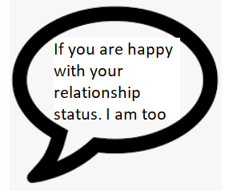
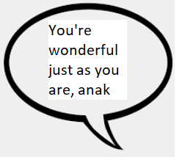
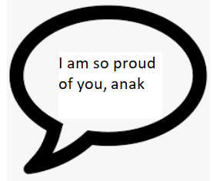
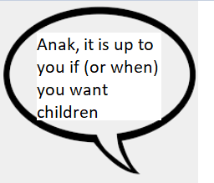
Therapy Options
Parents & family members can seek out therapy to:
Work through their own trauma
Speak to someone about their emotional well being
learn new techniques to process emotions in a healthy manner
Why is it important to seek therapy?
Stress related illnesses amongst the Filipino community is high
Physical and emotional well being are closely tied together
To strengthen healthy relationships with other family members
To live happier, healthier lives

Slide 10
References
Bahrami B, Dolatshahi B, Pourshahbaz A, Mohammadkhani P. Comparison of Personality among Mothers with Different Parenting Styles. Iran J Psychiatry. 2018 Jul;13(3):200-206. PMID: 30319703; PMCID: PMC6178334.
Baylosis, M. (2019, August 23). Toxic Filipino Culture? INQUIRER.net. Retrieved October 4, 2022, from https://opinion.inquirer.net/123484/toxic-filipino-culture

